Slide 1

Data cleaning techniques in Excel

Slide 2
Data Quality ★
Key Aspects of Data Quality:
❖ Accuracy: Data accurately reflects the real-world scenario.
❖ Completeness: Data is comprehensive and lacks missing values.
❖ Consistency: Data is uniform and follows a standard format.
❖ Relevance: Data is relevant to the analysis or decision-making process.
❖ Timeliness: Data is up-to-date and reflects the current state of affairs
Data quality refers to the reliability and accuracy of data.
High-quality data is consistent, complete, and free from errors, ensuring it is suitable for analysis and decision-making.

Slide 3

Data Cleaning
Data cleaning, also known as data cleansing or data scrubbing, is a fundamental process in data preparation.
It is the process of identifying and correcting errors, inconsistencies, and inaccuracies in datasets to improve data quality and integrity.
Data cleaning is a critical step in the data analysis process.
By ensuring data quality, organizations can make informed decisions, build trust in their data, and derive meaningful insights

Slide 4

Why is Data Cleaning ??
Accurate Analysis: Clean data ensures accurate and reliable analysis, leading to better decision-making.
Avoiding Errors: Incorrect or inconsistent data can lead to errors in calculations and interpretations.
Enhancing Trust: Clean data builds trust in the conclusions drawn from the data.
Compliance: Some industries, like finance or healthcare, have strict data quality standards for compliance

Slide 5

SteSteps/Techniques for Data Cleaning
1. Handling Missing Data
2. Removing Duplicates
3. Standardizing Formats
4. Correcting Inconsistencies
5. Outlier Detection and Treatment
6. Normalization and Scaling
7. Validating Data
8. Type Conversion
9. Dealing with Inconsistent Units

Slide 6
Missing Values
Missing data is a common issue in datasets and can adversely affect analysis and decision-making.
Identifying Missing Values
★ Blank Cells: Empty cells in a column may indicate missing values.
★ Excel Functions for the Identification:
➔ COUNTBLANK: =COUNTBLANK(range)
◆ Counts the number of blank cells in a specified range.
➔ ISBLANK: =ISBLANK(value)
◆ Returns TRUE if a cell is empty, else returns FALSE if it contains any data, including spaces.

Slide 7

Handling Missing Values
Imputation:
Imputation is the process of replacing missing values with default values based on the column's characteristics.
For numerical columns, you can impute the mean or median.
For categorical columns, you may use the mode (the most frequent category).
Deleting Rows or Columns:
If the missing values don't significantly impact the analysis, consider deleting the corresponding rows or columns based on the severity of missing values.

Slide 8
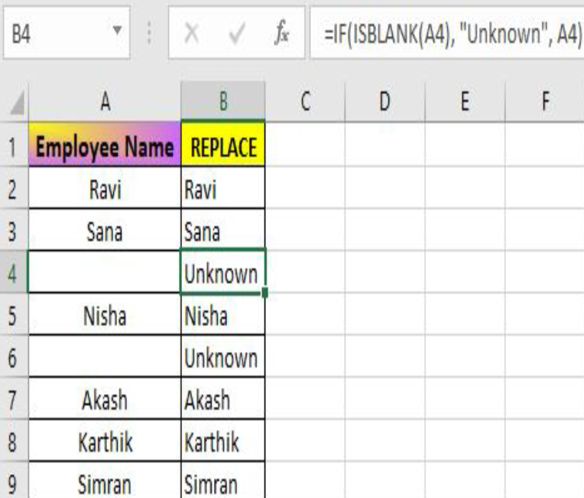
Replacing Missing Values
Replacement Strategies:
➔ Use Constants or Default Values:
◆ Replace missing values with constants or default values.
◆ =IF(ISBLANK(A2), "Unknown", A2)

Slide 9

Removing Duplicates in Data
Dealing with duplicates is a critical aspect of data cleaning, ensuring that the dataset is free from inaccuracies and bias, and it accurately represents the phenomena that is been analyzed.
Duplicate data within a dataset can lead to various challenges and issues that may compromise the accuracy, consistency, reliability, and efficiency of data analysis and decision-making processes.

Slide 10
Finding and Removing Duplicate Rows
1) Select the entire table.
2) Go to the "Data" tab in the Ribbon.
3) Click on "Remove Duplicates."
4) In the Remove Duplicates dialog box, select the columns to check for duplicates.
5) Click "OK."
➔ Excel will remove the duplicate rows based on the selected columns

Slide 11
Removing unnecessary Characters and Spaces
TRIM
Function removes leading and trailing spaces from a text string, leaving only single spaces between words.
Syntax: =TRIM(text)
CLEAN
Function removes non-printable characters from a text string. Useful for cleaning up text imported from external sources.
Syntax: =CLEAN (text)
SUBSTITUTE
Function replaces occurrences of a specified substring with another substring in a text string.
Syntax: =SUBSTITUTE
(text, old_text, new_text, [instance_num])
Cleaning data includes the removal of unnecessary characters and spaces to enhance consistency and prepare it for analysis. Unwanted characters, extra spaces, and irregular formatting can hinder accurate computations and visualizations

Slide 12
Standardize Text Formats
Standardizing text formats and ensuring consistency in your data is crucial for accurate analysis and reporting.
Excel provides a powerful "Find and Replace" feature that allows you to quickly address typos, standardize capitalization, correct spacing, etc.
➔ Press Ctrl + F to open the "Find and Replace" dialog.
➔ Or, Go to the "Home" tab, click on "Find & Select," and choose "Replace."

Slide 13
Conclusion
Data cleaning is a critical and often time-consuming part of the data preparation process. Ensuring data quality is paramount for accurate analysis, modeling, and decision-making. By effectively handling issues like missing values, duplicates, outliers, and inconsistent formats, the dataset becomes reliable and ready for meaningful insights.

Slide 14

Thank you !!!
ajaycraju98@gmail.com

